Slide 1
CluedIn Fundamentals: Identifying and labelling incorrect data
Strategies for imposing data quality standards by using the tagging mechanism in CluedIn

Slide 2
Review data ingestion outcomes
Explore the concept of tags in CluedIn
Training agenda
Learn about typical scenarios for tracking incorrect data
Demo of identifying and labelling incorrect data

Slide 3


Data ingestion outcomes
As a result of ingesting CRM and ERP records, we now have 10,000 Customer golden records in the system.
CRM
ERP

Slide 4
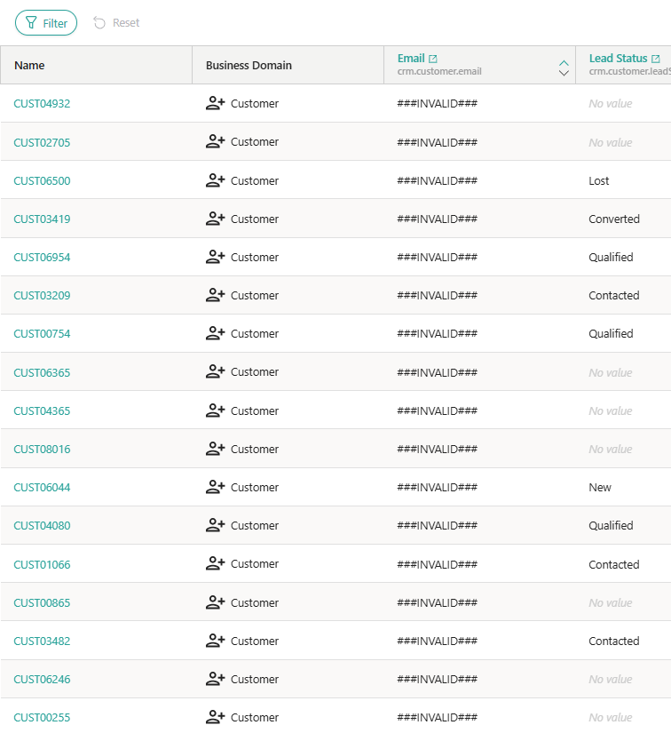
We ingested raw data, without any data validations in place. However, upon closer inspection, there are multiple data quality issues.
How do we identify and label golden records that need to be fixed?
How do we ensure that data is accurate and consistent?

Slide 5
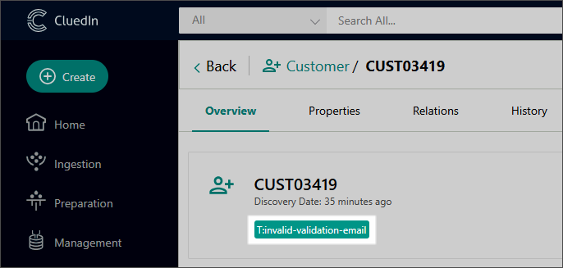
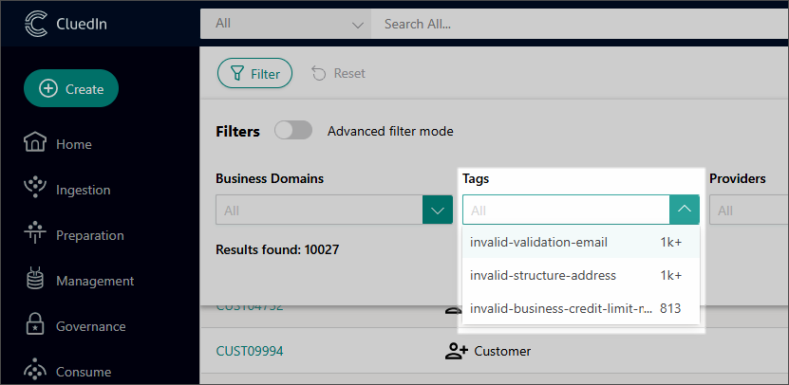

Tagging mechanism in CluedIn
With tags, you can categorize golden records into groups—for example, a separate group for records with missing properties, a separate group for records with invalid properties, and so on.
Tags should always be applied directly on the golden record, which acts as your single source of truth.

Slide 6
Recommended types of tags
01
02
03
Structural tags
Data quality tags
Business logic tags

Slide 7

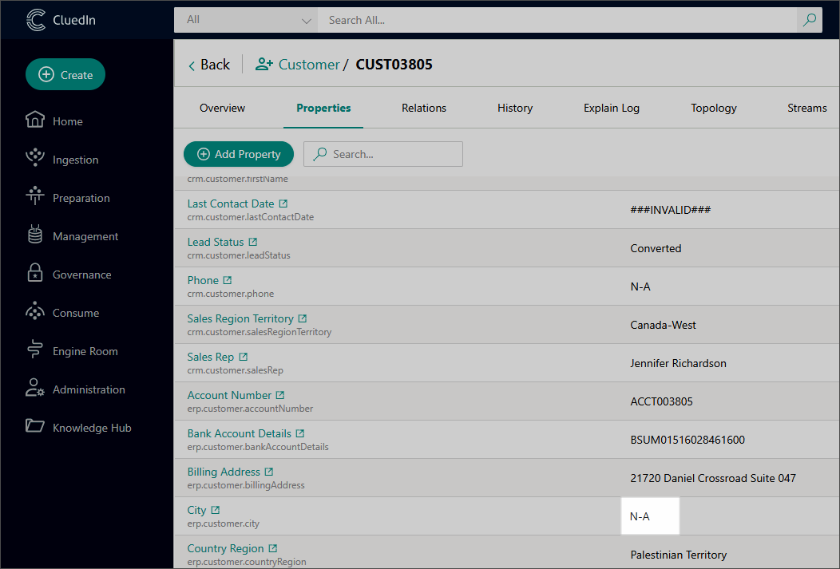
Structural tags
Structural tags can be used to check for missing fields based on the expected data structure.
For example, you might require that all golden records include address details. If any details, such as city or postal code, are missing, the golden record will be tagged as invalid.

Slide 8
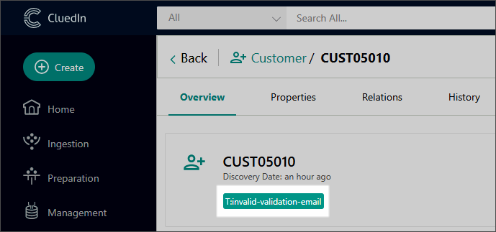
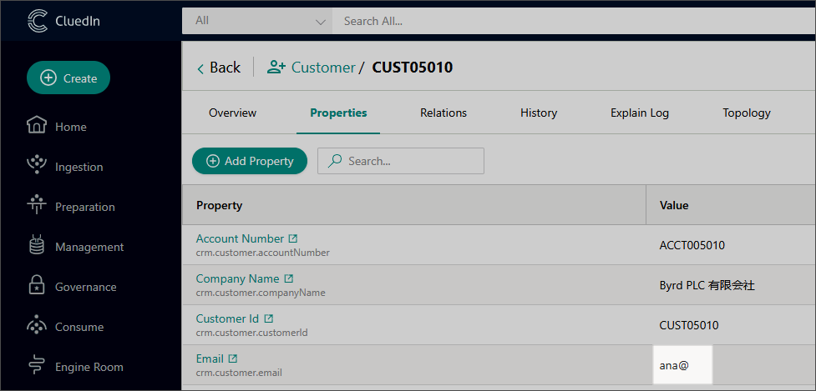
Data quality tags
Data quality tags ensure that field values follow expected formats. This is applicable to emails, phone numbers, and country codes. Whenever values do not match the specified pattern, the golden record will be tagged as invalid.

Slide 9
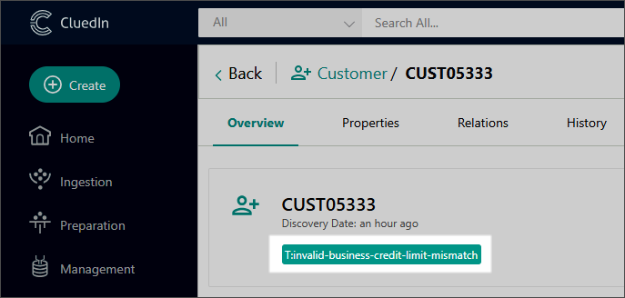
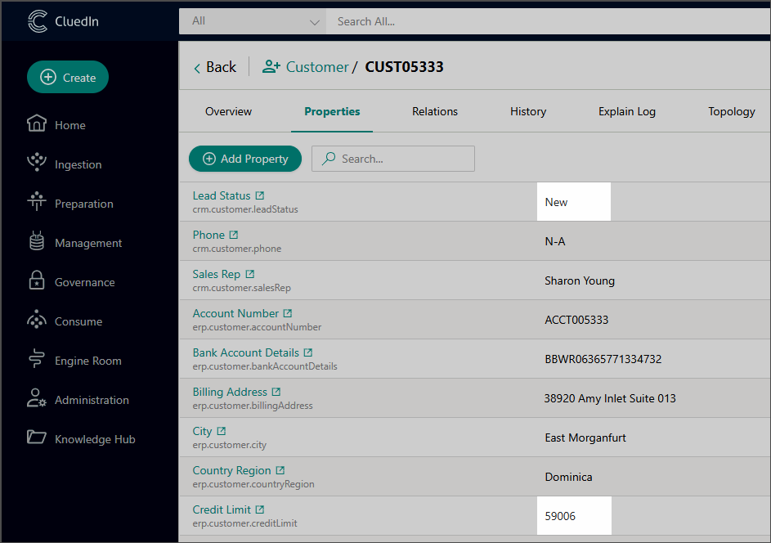
Business logic tags
Business logic tags are applied when values across multiple fields in a golden record must align logically. For instance, if a Lead is marked as New, its Credit Limit must be zero. If it is not, the record will be marked as invalid.

Slide 10
Naming conventions for tags
The word "invalid"—followed by a category—and then by a specific issue.
#invalid-structure-address
#invalid-validation-email
#invalid-business-credit-limit-mismatch

Slide 11
DEMO: Identifying and labelling records with invalid data

Slide 12
Demo summary
You’ve seen how to:
Find and label golden records with invalid data
Use three types of tags (structural tags, data quality tags, and business logic tags) to impose different types of validations
Outcome:
You now understand how to use the tagging mechanism to manage data quality and effectively track invalid records.
Next step:
Pause the video and replicate the process.

Slide 13
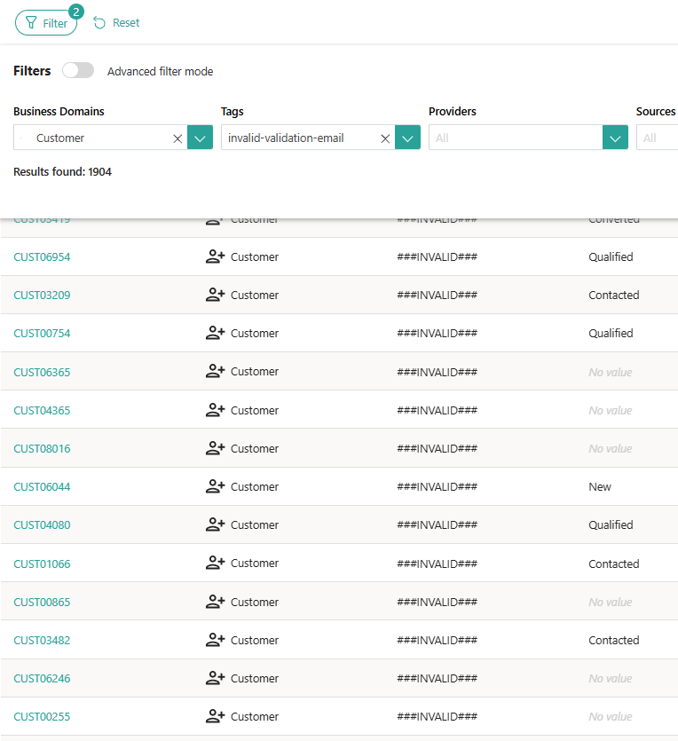


Learn more about golden record rules in our documentation portal.
Next session: Using reference data and lookup values to standardize and categorize your data.
What’s next?

